Slide 1

Introduction to
Gunjan Kumar

Slide 2
Agenda
JavaScript you need to know
What is jQuery
Getting Started
the famous $ sign
selectors and managing wrapped set
Manipulating attributes, class, content for elements
DOM traversal and manipulation
some utility functions
effects provided by jQuery core
events and getting close to unobtrusive JavaScript
template
Ajax
jQuery Plugin
jQuery UI
jQuery Mobile

Slide 3
What is jQuery
Per their website, “jQuery is a fast and concise JavaScript Library that simplifies HTML document traversing, event handling, animating, and Ajax interactions for rapid web development.”
It was first released in Jan 2006, current release is 1.4.4
Lightweight (24KB), CSS3 compliant, Cross Browser
A separate UI library and Mobile Library
Per http://en.wikipedia.org/wiki/JQuery, used by over 41% of the 10,000 most visited websites (majors like Google, Dell, Bank of America, NBC, Netflix … )
Supported by Microsoft as well ☺
Per http://trends.builtwith.com/, jQuery and jQuery UI constitute around 50% of all JS libraries used on the web

Slide 4
Other JS libraries
SWFObject is a small Javascript file used for embedding Adobe Flash content (http://code.google.com/p/swfobject/ )
Prototype : http://www.prototypejs.org/
The Yahoo! User Interface (YUI) Library : http://developer.yahoo.com/yui/
script.aculo.us : http://script.aculo.us/
MooTools : http://mootools.net/
Google Mashup Editor (GME) : retired but still in use http://code.google.com/gme/

Slide 5
jQuery Resources
http://jquery.com/ : this is the core website.
http://docs.jquery.com/Main_Page : developer’s starting page
http://docs.jquery.com/Tutorials : tutorials
http://plugins.jquery.com/ : plugin repository
http://jqueryui.com/ : the UI library
http://jquerymobile.com/ : the mobile framework
http://www.manning.com/bibeault/ : best book on jQuery (in my opinion)

Slide 6
Getting Started
What you will need :
Core library (comes as MIN and FULL versions)
Download from http://docs.jquery.com/Downloading_jQuery
Use CDN hosted files (MS, Google, jQuery)
Visual Studio Intellisense Support
Download from http://code.jquery.com/jquery-1.4.1-vsdoc.js
UI
Download from http://jqueryui.com/download
This gives you js PLUS css
Mobile
Download from http://jquerymobile.com/download/
You will need js PLUS css
Now that you have the JS and CSS, refer to them and lets get started !!!
<script type="text/javascript" src="jquery.js"></script>

Slide 7
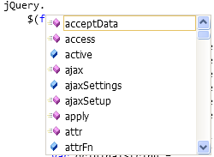


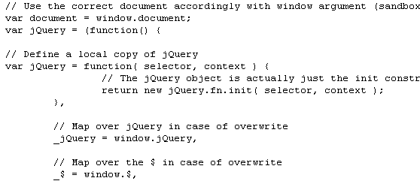
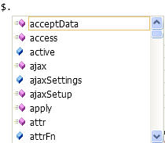
$ sign
$ is an alias to refer to the jQuery library
You can use either jQuery OR $ to refer to the library
Two main modes of usage
$. : Typically for utility methods
$( : Typically for selectors and document ready method

Slide 8
$(document).ready
“As almost everything we do when using jQuery reads or manipulates the document object model (DOM), we need to make sure that we start adding events etc. as soon as the DOM is ready. ”
Flavors of usage :
$(document).ready(function() {
//DO SOMETHING
});
$(function() {
//DO SOMETHING
});
function readyFn() {
// code to run when the document is ready
}
$(document).ready(readyFn);

Slide 9
Selectors
Used to select element(s) from DOM based on “selection criteria”
Gets us “wrapped set” of matching elements
$( selector, <context>)
selector defines the matching criteria
Context is optional parameter to restrict are where to match and is a selector in itself. By default, context is the entire document
Various types of selectors
CSS
Child, Attributes, Container
Position
Custom
$(“img”) – will select all images in the DOM
$(“img”, “#containerDiv”) – will select all images present in the element by name containerDiv

Slide 10
CSS Selectors
$(“a”)
This selector matches all link (<a>) elements.
$(“#specialID”)
This selector matches elements that have an id of specialID
$(“.specialClass”)
This selector matches elements that have the class of specialClass
$(“ a#specialID.specialClass”)
This selector matches links with an id of specialID and a class of specialClass
$(“p a.specialClass”)
This selector matches links with a class of specialClass declared within <p> elements.
$("div,span,p.myClass") – selects all divs, spans and paragraphs which have class myClass

Slide 11
Child, attributes, container selectors
$(“p > a”) matches links that are direct children of a <p> element
$("a[href^='http://']") matches links that start with http://
$("a[href$='.pdf']") matches links that end with .pdf
$("a[href*='google.com']") matches links that contain google.com
$("a[href='append.htm']") matches links that point to append.html
li:has(a) matches all <li> elements that contain an <a>

Slide 12
Position selectors
$("td:first") first td of the context (will select single element)
$("td:last“) last td of the context (will select single element)
$("td:even“) all even td of the context
$("td:odd“) all odd td in the context
$("td:eq(5)“) 6th td in the context (index from 0)
$("td:gt(5)“) 7th to last td in the context (index from 0)
$("td:lt(5)“) 1st to 5th td in the context (index from 0)
$("td:first-child“) first td of each row (will select first column)
$("td:last-child“) last td of each row (will select last column)
$("td:nth-child(3)“) 3rd td of each row (will select 3rd column, index from 1)
$("td:nth-child(even)“) all even td in each row (will select all even columns)
$("td:nth-child(odd)“) all odd td in each row (will select all odd columns)

Slide 13
Custom selectors
$(“input:checkbox”) all checkboxes
$(“input:radio:checked”) all radiobuttons that are checked
$(“input:checkbox:not(:checked):enabled”)
all checkboxes that are not checked and are enabled

Slide 14
Managing wrapped set
$("td").get(0) gets 1st element from wrapped set (index from 0)
$("td").toArray()[1] converts wrapped set to array of elements and gets 2nd element
$("td").eq(2) gets 3rd element from wrapped set but as wrapped element.
$("td").first() gets first element from wrapped set but as wrapped element.
$("td").last() gets last element from wrapped set but as wrapped element.
$("td").size() gets the size of the wrapped set
$('img').index($('#findMe')) gets the index of image with ID findMe in the set of all images
$('img[alt]').add('img[title]') <img> elements that have either an alt or a title
$('img[title]').not('[title*=puppy]') gets all images with have title but not containing puppy
$("input:checkbox").filter(":checked") filters list of all checkboxes to give only the ones that are checked
$("li").filter(".dummyClass").hide().end().addClass("selectedItem") hide the li with dummy class and add selectedItem class to all li

Slide 15
.each()
each(iterator) Traverses all elements in the matched set invoking the passed iterator function for each.
iterator (Function) A function called for each element in the matched set. The parameter passed to this function is set to the zero-based index of the element within the set, and the element itself is available as the this property of the function.
Returns wrapped set (important for chaining)
$('img').each(function(n){
this.alt='This is image['+n+'] with an id of '+this.id;
});

Slide 16
Attributes
$("#txtDemo").attr("data-custom")
gets the value of attribute "data-custom"
$("#txtDemo").removeAttr("data-custom")
removes the attribute "data-custom"
$("#txtDemo").attr("data-custom", "updated value for attribute")
sets value of attribute "data-custom" to updated value for attribute"
this can be used to add an attribute OR update the value of existing attribute
$("#txtDemo").attr({ title: 'updated value for title', value: 'content changed as well', 'data-custom' : 'updated value of custom attrib again' }) sets multiple attributes
$("input:checkbox").removeAttr('disabled'); enables all checkbox
$("input:checkbox").attr('disabled', true); disables all checkoxes
$("a[href^=http://]").attr("target","_blank") all links starting with http will open in new window

Slide 17
Styling
$("#trFirstRow").addClass("selectedItem")
add class selectedItem to trFirstRow
$("#trFirstRow").removeClass("selectedItem")
remove class selectedItem to trFirstRow
$("#trFirstRow").addClass("customClass")
add class customClass to trFirstRow
$("#trFirstRow").removeClass("customClass")
remove class customClass to trFirstRow
$("#trFirstRow").toggleClass("customClass")
toggles the class customClass to trFirstRow (add if not present, remove if present)
$("#trFirstRow").css({border: '1px solid Black',background: 'Blue',color: 'White'}) add multiple css attributes
$("#trFirstRow").css("background-color") gets the css attribute's value
$("#trFirstRow").height(80) sets height
$("#trFirstRow").width() gets width

Slide 18
Content
$("#demoDiv").html() gets the html content of the div (formatting info as well)
$("#demoDiv").html("This is a formatted <b>HTML</b> content which has some <i>random formatting.</i> updated")
sets the html content of the div. So we will see HTML in bold
$("#demoDiv").text() gets the content as text (no formatting information)
$("#demoDiv").text("This is a formatted <b>HTML</b> content which has some <i>random formatting.</i> updated but as you see, formatting is gone");
sets text content of div. No formatting
$("input:text").val("Updated the content ") ; VAL is only for form elements
Sets the value of textboxes. .val() will get us the content
$("input:button").eq(0).val("GET VALUE");
Sets the value of button (text that we see). .val() will get us the current content
$("select").val("tiger"); selects the option with value tiger in the select control

Slide 19
Creating new element
Html content within $(“”) generates a new element which then needs to be added to DOM using append / prepend or any such method
Flavors
Specifying the full html : $('<p>This is a new paragraph</p>');
Specifying the attributes : $('<a/>', {
html : 'This is a <strong>new</strong> link',
'class' : 'new',
href : 'foo.html'
});

Slide 20
Modifying the DOM tree
$("#coffee").append("<li>" + $("#drinkName").val() + "</li>")
<li id="coffee">Coffee</li> becomes <li id="coffee">Coffee<li>test</li></li>
$("#coffee").prepend("<li>" + $("#drinkName").val() + "</li>");
<li id="coffee">Coffee</li> becomes <li id="coffee"><li>test</li>Coffee</li>
$("#coffee").after("<li>" + $("#drinkName").val() + "</li>");
<li id="coffee">Coffee</li> becomes <li id="coffee">Coffee</li> <li>Test</li>
$("#coffee").before("<li>" + $("#drinkName").val() + "</li>");
<li id="coffee">Coffee</li> becomes <li>Test</li> <li id="coffee">Coffee</li>
$("#blackTea").remove();
removes the element from DOM
$("#tea").clone().appendTo("#milk") clones tea and appends to milk
$("#tea").wrap("<div></div>") adds a wrapper div element over tea (<div><li id="tea">Tea</li></div>)

Slide 21
DOM Traversal
$("#subChildLI").children() gets all direct children
$("#subChildLI").closest("tr") gets closest tr in DOM hierarchy
$("#subChildLI").parent() gets immediate parent
$("#subChildLI").parents("ul") gets all ul parents in DOM hierarchy (filtered)
$("#subChildLI").parents() gets all parents in the DOM hierarchy
$("#subChildLI").siblings() gets all siblings of selected element
$("#subChildLI").prev() gets previous sibling
$("#subChildLI").next() gets next sibling

Slide 22
Utility functions
Functions we looked at so far operated on jQuery object if you will
These are all in the $.fn namespace
called on jQuery selections
automatically receive and return the selection as this
Another set of functions are called Utility methods
These are in the $ namespace
do not work with selections
they are not automatically passed any arguments, and their return value will vary

Slide 23
Utility functions : browser support
$.browser provides flags that help in determining the user agent
$.browser.version gives the version of the browser’s rendering engine
$.browser.msie / firefox / opera / safari is set to true based on user agent
$.cssFloat, $.opacity etc used to determine browser’s support for various capabilities
$.boxModel
Box model : true if the page is using the W3C standard box model and false if the page is using the Internet Explorer box model (traditional). Under the W3C box model, the size of the content of the element is 180 by 72 pixels exactly as specified by the width and height values. The padding and the border are applied outside this 180 by 72 pixel box, resulting in a total footprint of 210 by 102 pixels for the entire element. When the traditional box model is used, the entire element is rendered in the 180 by 72 pixel box defined by the width and height attributes, reducing the size of the content to 150 by 42 pixels

Slide 24
Utility functions (contd.)
$.noConflict() sets $ free for usage by another library. Post this, use jQuery instead of $
$.param converts string / object to query string taking care of formatting and encoding
Original object
{firstName: 'Yogi',lastName: 'Bear',streetAddress: '123 Anywhere Lane',city: 'Austin',state: 'TX',postalCode: '78701'}
serialized to query string
firstName=Yogi&lastName=Bear&streetAddress=123+Anywhere+Lane&city=Austin&state=TX&postalCode=78701
$.makeArray(object) Converts the passed array-like object into a JavaScript array
$.unique(array) Given an array of DOM elements, returns an array of the unique elements in the original array
$.parseJSON(string) parses jsonString and gives object evaluating the string

Slide 25
Manipulating objects and collections
$.trim(“ text with spaces “) trims the string
$.each(anyArray, function (n, value){
//here you get the index and value for each element
});
$.each(anyObject, function (name, value){
//here you get name and value one by one
});
$.inArray(56, originalArray)
checks for number 56 as an element in the array. If present, returns the index ELSE returns -1

Slide 26
Manipulating objects and collections
Filter an array using $.grep
var grepArray = $.grep(originalArray, function (a) { return a > 50; });
var anotherGrepArray = $.grep(originalArray, function (value) {
return value > 50;
}, true);
Note that the filter is works as an iterator calling the function for each row and adding to the result set IF function returns TRUE
In the second approach, we have option to say if we want to invert the filtering
Translate an array using $.map which applies a function to each element in the original array to get the result set
var valuesArray = $.map(stringArray, function (value) {
var result = new Number(value);
return isNaN(result) ? null : 5*result;
});

Slide 27
Animations and effects
For examples, we will refer to source code from the book : http://localhost/jqia2.source/chapter5/lab.effects.html
Each of these methods optionally take
a speed param – number in milliseconds or text like Slow, Normal, Fast
call back function reference that will be invoked once effect is complete
fadeTo needs opacity to be defined
$(“#sampleDiv”).hide(“slow”) hides the element
$(“#sampleDiv”).show(“slow”) shows the element
$(“#sampleDiv”).toggle(“slow”) toggles the visibility state of the element
$(“#sampleDiv”).fadeIn(“slow”) hidden element is shown by changing opacity
$(“#sampleDiv”).fadeOut(“slow”) element is hidden by changing opacity
$(“#sampleDiv”).fadeTo(“slow”, 0.5) changes the opacity to 0.5
$(“#sampleDiv”).slideUp(“slow”) collapses the element
$(“#sampleDiv”).slideDown(“slow”) expands the element
$(“#sampleDiv”).slideToggle(“slow”) toggles the slide of the element

Slide 28
Creating custom effects
animate(properties, speed) can be used to make custom effects
Properties is an object specifying the target values for various css properties
Speed specifies the time needed to reach this target state
Additionally, we can specify callback as well
$('.animateMe').each(function(){
$(this).animate(
{
width: $(this).width() * 2,
height: $(this).height() * 2
},
2000
);
});

Slide 29
Events
Binding events, handling event object and passing data to events have been chaotic conventionally
jQuery gives multiple handy ways to make this simpler
Bind, unbind
Inspect event instance
Trigger
When binding, we can bind multiple handlers in two ways
Specifying all of them by bind() will fire them all when the event is triggered
Using toggle() will fire them as if a circular list – each trigger picks up the next handler

Slide 30
Binding events
Bind a function directly to the event
bind method that takes event name(s), data to be passed to event handler and callback function (reference or inline definition)
Many common events are present by name to be either specified in bind method OR use the first approach – blur, click, dblclick, change, focus etc
Similar to bind(), one() can be used – this unbinds the handler after being called once
Remove a handler by unbind() method
$('p').click(function() { console.log('click');});
$('p').bind('click', function() { console.log('click');})
$('input').bind( 'click change', // bind to multiple events
{ foo : 'bar' }, // pass in data
function(eventObject) {
console.log(eventObject.type, eventObject.data);
}
);

Slide 31
Trigger events
Broadly 3 ways
Invoke the trigger() method which accepts event name and data
Invoke triggerHandler() method which operates as trigger() BUT doenst propagate the event
As seen with binding, we can call the event name directly for some methods – click(), blur(), focus()
When binding, we can bind multiple handlers

Slide 32
Templates
Helps create a HTML template that can be repeatedly used
Plugin that you will need to download from https://github.com/jquery/jquery-tmpl/blob/master/jquery.tmpl.min.js
Two small steps
Define the markup and associate to a name
Apply template
When we pass an object, its properties can be accessed by ${NAME}
When we pass a list, the template iterates over each object in the list
<script id="summaryTemplate" type="text/x-jquery-tmpl">
<li>${Name}</li>
</script>
function renderList() {
$( "#summaryTemplate" ).tmpl( movies ).appendTo( "#moviesList" );
//OR : $.tmpl( "summaryTemplate", movies ).appendTo( "#movieList" );
}

Slide 33
Ajax
GET vs POST
Use GET only for “getting” data, pass criteria as query string, typically gets cached
Use POST for CUD (CRUD-R)
Data types (for GET, this is return data, for POST this is send data)
text, html, xml, json, jsonp, script
Core method : $.ajax({});
url specifies the URL for get / post
dataType specifies the type of data expected to be sent / received in POST / GET
data specifies the data being POSTed. Can also be query string
type specifies the type of call – POST / GET typically
success is a pointer to the callback function when response is 200 OK
error and complete are pointers to functions on error and complete – more like catch and finally in try-catch blocks.
Convenience methods that default some of the properties : $.get, $.post, $.getJSON
Accept url (mandatory), data, dataType and success as params

Slide 34
Ajax GET
var noteData;
function DemoLoadData() {
$.ajax({
type: "GET",
url: "http://localhost/NoteApp/NoteService/Service.svc/GetNoteData",
cache: false,
success: LoadDataSucceeded,
error: LoadDataFailed
});
}
function LoadDataSucceeded(msg) {
alert(msg);
$("#jsonContainer").val(msg);
noteData = JSON.parse(msg);
}
function LoadDataFailed(result) {
alert(result.status + ' ' + result.statusText);
}

Slide 35
Ajax POST
function SaveNoteData() {
var objectData = JSON.stringify(noteData);
$.ajax({
url: "http://localhost/NoteApp/NoteService/Service.svc/SaveNoteData",
type: 'post',
dataType: 'json',
contentType: 'application/json; charset=utf-8',
data: JSON.stringify(noteData),
success: function (res) {
alert(res);
},
error: function (xhr) {
if (xhr.responseText) {
var err = JSON.parse(xhr.responseText);
if (err)
alert(err);
else
alert({ Message: "Unknown server error." })
}
return;
}
});
}

Slide 36
Ajax convenience methods
// get plain text or html
$.get(‘myservice.svc/GetAllData', { employeeID: 1234 }, function(resp) {
console.log(resp);
});
// get JSON-formatted data from the server
$.getJSON(' myservice.svc/GetAllDataJSON', function(resp) {
$.each(resp, function(k, v) {
console.log(k + ' : ' + v);
});
});

Slide 37
jQuery Plug-in
A new method that we use to extend jQuery's prototype object
Can be used privately or shared with others
Since extending prototype, it is available for all jQuery objects
Guidelines
Name the file as jquery.PLUGINNAME.js
Name in file and your method’s name should be same
Keep track of developer community to avoid name conflicts ☺
Wrap the actual plugin in an immediately-invoked function:
(function($){
//...
}(jQuery));
Because of closure, this creates a "private" scope of $ hence allowing us to extend jQuery without risk of $ being overwritten by another library

Slide 38
jQuery Plug-in development
Utility functions
$.functionName = function(params){function-body};
Invoked as $.functionName(params)
Wrapper methods
These will operate on DOM and will need to support chaining
$.fn.wrapperFunctionName = function(params){function-body};
Invoked as $(selector).functionName(params)
(function($){
$.say = function(what) { alert('I say '+what); }
})(jQuery);
(function ($) {
$.fn.makeItBlueOrRed = function () {
return this.each(function () {
$(this).css('color', $(this).is('[id]') ? 'blue' : 'red');
});
};
})(jQuery);

Slide 39
jQuery UI
http://jqueryui.com/demos/
Use jQuery UI to get lot of available controls that can enhance the UI on your page
The link takes you to demo page to show what is available from jQuery
Beyond this, you can find much more by just searching for jQuery UI Plugins for almost anything you want

Slide 40
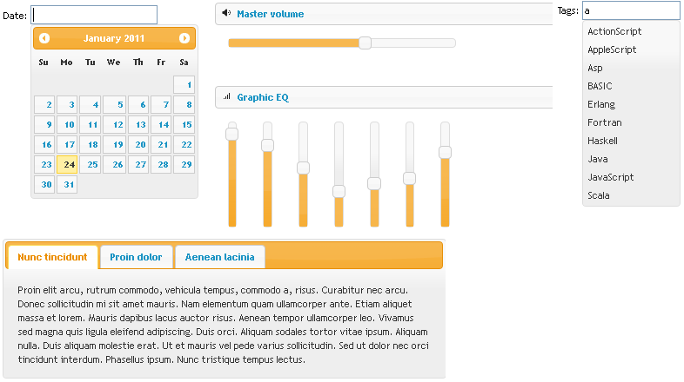
What's on offer?

Slide 41
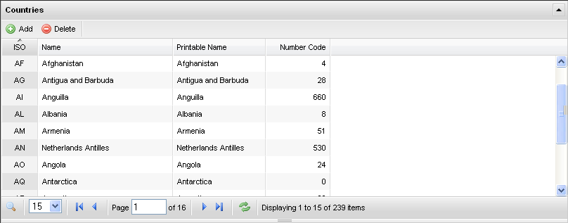
Third party controls
An example : http://www.flexigrid.info/
Starting from as simple a code usage as
$('.flexme').flexigrid();

Slide 42
jQuery Mobile
http://jquerymobile.com/
The above URL takes you to the home of jQuery mobile framework
Demo pages show what this can do
Since mostly uses CSS3 / HTML5, IE 7 / 8 doesn’t support this
However IE9 and most of other browsers – Firefox, Safari, Opera – show this correctly
Given that most of mobile’s web browsers are supporting this, we should be good to use the power of this framework

Slide 43
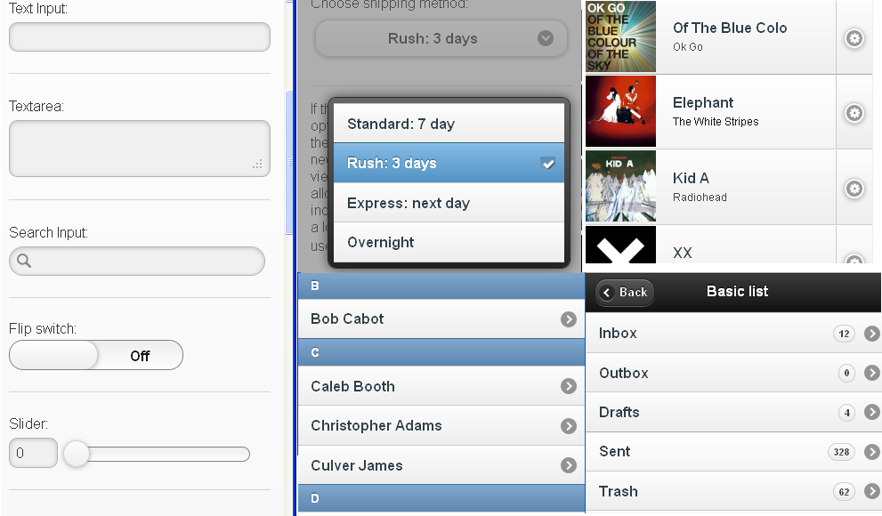
How does it change my UI?

Slide 44
References
http://docs.jquery.com/Plugins/Authoring
http://nsreekanth.blogspot.com/search/label/JQuery%20plugin
http://msdn.microsoft.com/en-gb/scriptjunkie/ee730275.aspx
http://msdn.microsoft.com/en-gb/scriptjunkie/ff848255.aspx
http://jqfundamentals.com/book/book.html
http://nsreekanth.blogspot.com/search/label/JQuery%20plugin
http://jquery.com/ : this is the core website.
http://docs.jquery.com/Main_Page : developer’s starting page
http://docs.jquery.com/Tutorials : tutorials
http://plugins.jquery.com/ : plugin repository
http://jqueryui.com/ : the UI library
http://jquerymobile.com/ : the mobile framework
http://www.manning.com/bibeault/ : best book on jQuery (in my opinion)

Slide 45
Q and A
?

Slide 46
Thank You ☺
gunjan.kumar@qwest.com

